Slide 1
Estimate in statistical terms

Slide 2
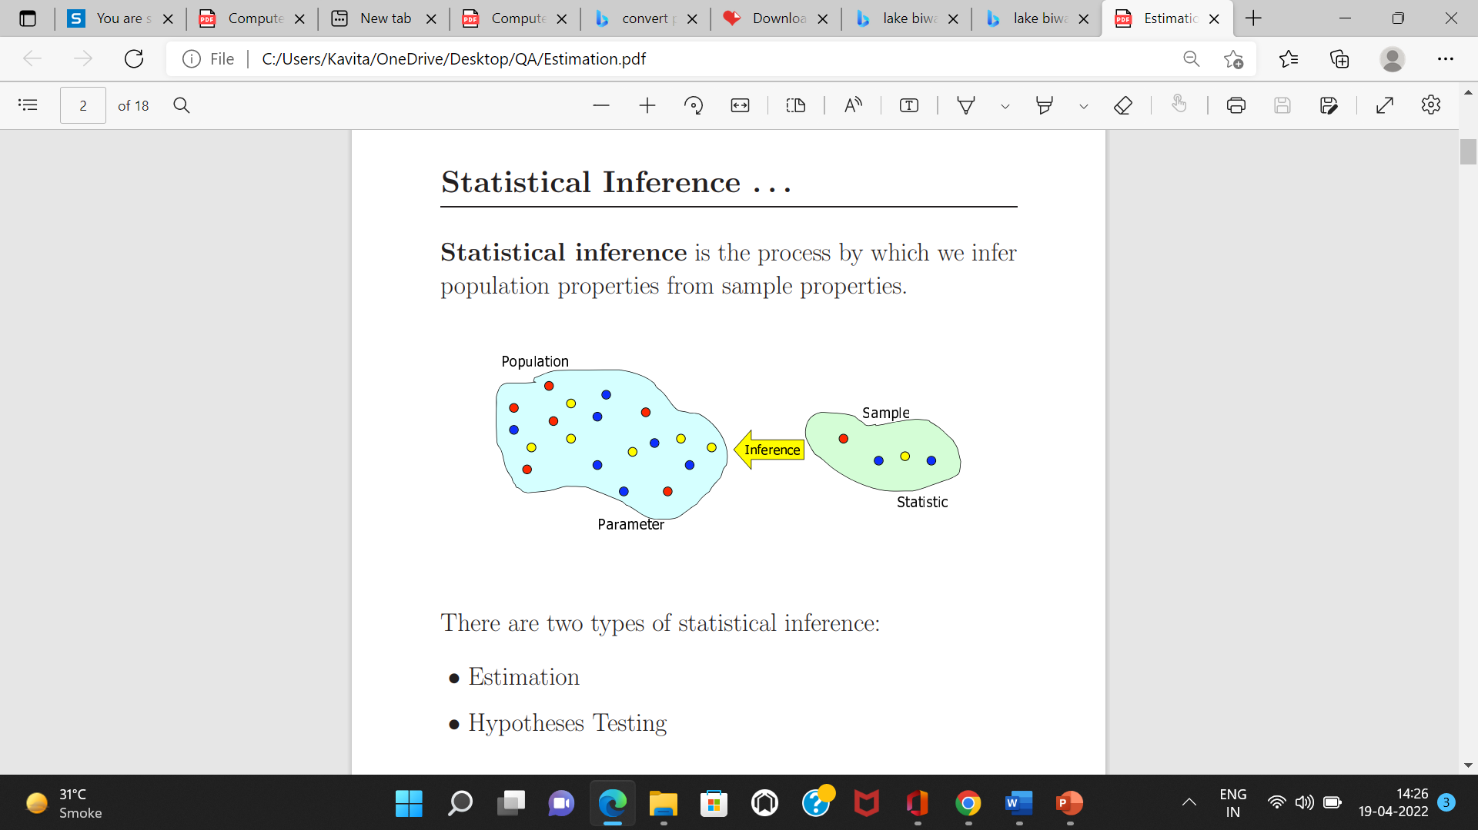
Statistical Inference
Statistical inference is the process by which we infer population properties from sample properties
There are two types of statistical inference:
• Estimation
• Hypotheses Testing

Slide 3
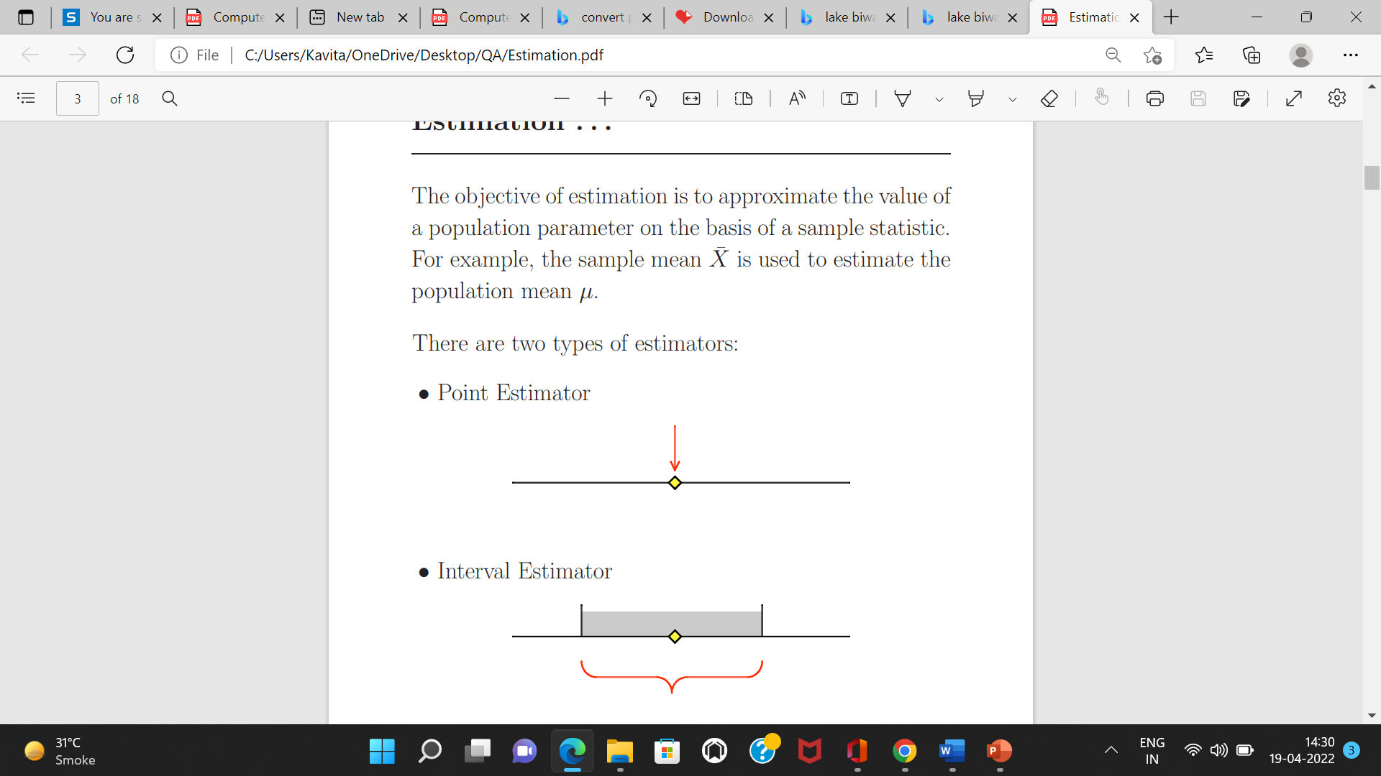
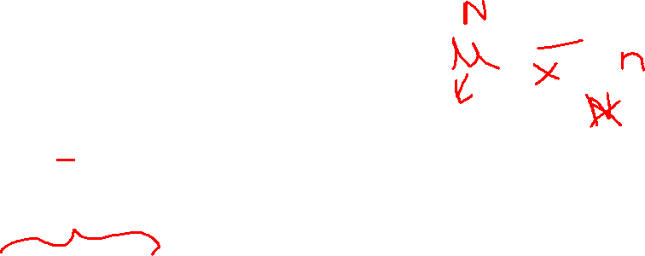
Estimate in statistical terms
Estimate is a specific observed numerical value used to estimate an unknown population parameter or gives you some facts about how the population could be.
Two types of estimates about the population.
Point Estimate
Interval Estimate

Slide 4
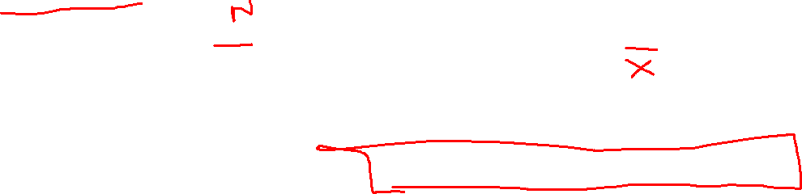
Estimate in statistical terms
Point Estimate
Suppose we have some population and we take a sample from this population and measure their weights estimate mean.
If the average weight is 60 Kg.
Then 60 kgs of sample mean is a Point estimate of a population mean.
Point estimate is often insufficient because its is either wrong or right.
Assuming that we know its is wrong, but you don’t know how wrong it
Assuming we came of know that you are off target by 5 kg, then you would expect 60k as good estimate but if the estimate is off by 30kg then it is not the right estimate of population.

Slide 5
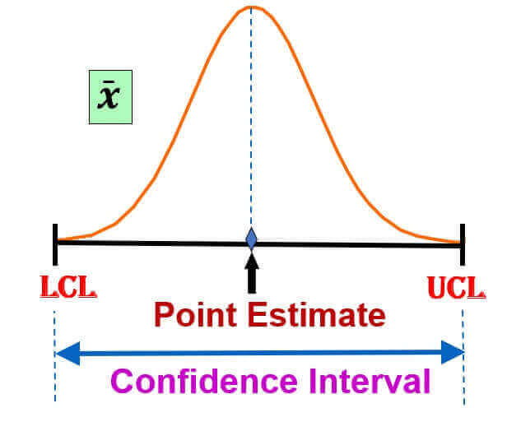
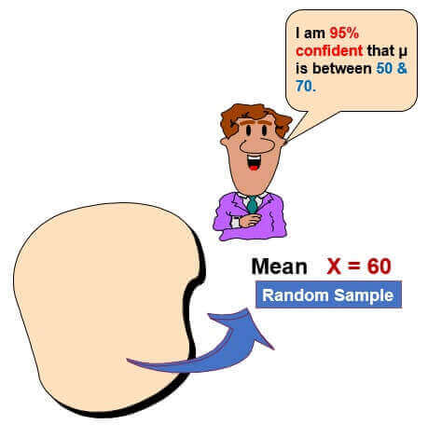
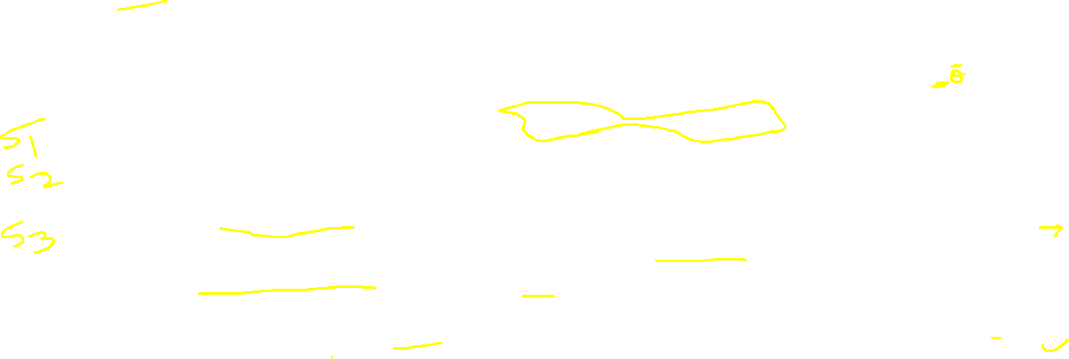
Estimate in statistical terms
Interval Estimate
A point estimates is a single value, we can’t really tell how good it represents the population.
So in inferential statistics, we prefer to use an interval or a range of values to estimate the population parameter.
It gives you the range of values by calculating two different numbers between which we can expect the parameter to lie.
So we construct Interval estimate with degree of certain degree of confidence say for e.g. 95% confidence.

Slide 6
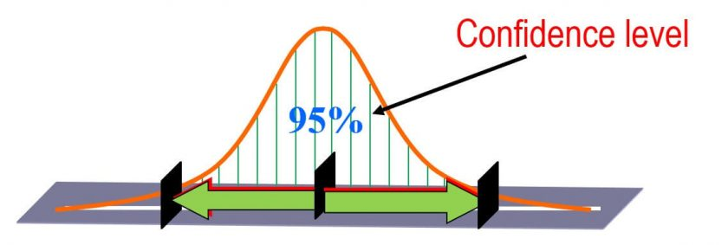
Estimate in statistical terms
Confidence Interval
Confidence interval is the range of estimate we are making.
Confidence levels are normally expressed as % ( For e.g. 95 % confidence level).
A confidence interval communicates how accurate our estimate is likely to be.
A confidence interval is used to express the range in which we are pretty sure the population parameter lies. These confidence Interval give us an idea about the size and thus the power of a study.
The size of the confidence interval is then directly related to the size of the study.
The more participants the smaller the confidence interval and the more precise the estimated effect.
The confidence interval estimate for a population mean lies between the sample mean – the margin of Error and the sample mean + the margin of Error.
The margin of error is calculated based on a confidence level. The confidence level basically refers to the percent of confidence intervals (from many samples) that we expect to contain the true population parameter.
Confidence levels of 90%, 95%, and 99% are often used, but 95% is the most commonly used confidence level
Confidence Interval = “Point estimate” +/- “Margin of Error”
Where Margin of errors are the upper and Lower limits of confidence Interval.

Slide 7
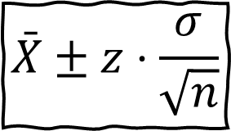
A random sample of n = 50 males showed a mean average daily intake of dairy products equal to 756 grams with a standard deviation of 35 grams. Find a 95% and 99% confidence interval for the population average U ?
Ans: x ̄ = 756 grams ; n= 50 , σ = 35 ,
The Z-value can be derived from the table and its shows us which area is contained in the confidence interval of our result so in case of the 95% confidence interval we take although use between minus 1.96 times and plus 1.96 times the standard deviation. A lower confidence interval will lead to a lower Z-value and a smaller interval and vice versa
From Z table for 95 % confidence interval we get value as 1.96.
=> Interval estimate is = 756±1.96×35/√50
=> 746.30 ≤ m ≤ 765.70 grams for 95 % confidence interval
Now for 99 % confidence interval and From Z table for 99 % CI we get value as 2.576
=> 756±2.576×35/√50
=> 743.23 ≤m≤ 768.77 grams for 99 % confidence interval.

Slide 8

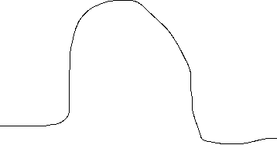








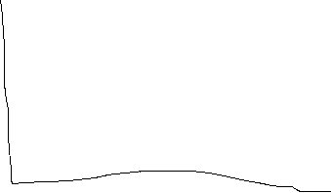



Example
x ̄ = 76 , σ =4; 95% CI
95% of the time n is within 2σ of x ̄ is within the range 68 to 84

Slide 9
The desirability of an estimator is judged by its characteristics. Three important criteria are:
Unbiasedness
Consistency
Efficiency

Slide 10
Unbiasedness…
An unbiased estimator of a population parameter is an estimator whose expected value is equal to that parameter. Formally, an estimator ˆµ for parameter µ is said to be unbiased if:
E(ˆµ) = µ
Example: The sample mean X¯ is an unbiased estimator for the population mean µ, since
E(X¯ ) = µ .
It is important to realize that other estimators for the population mean exist: maximum value in a sample, minimum value in a sample, average of the maximum and the minimum values in a sample . . .
Being unbiased is a minimal requirement for an estimator.
For example, the maximum value in a sample is not unbiased, and hence should not be used as an estimator for µ.

Slide 11
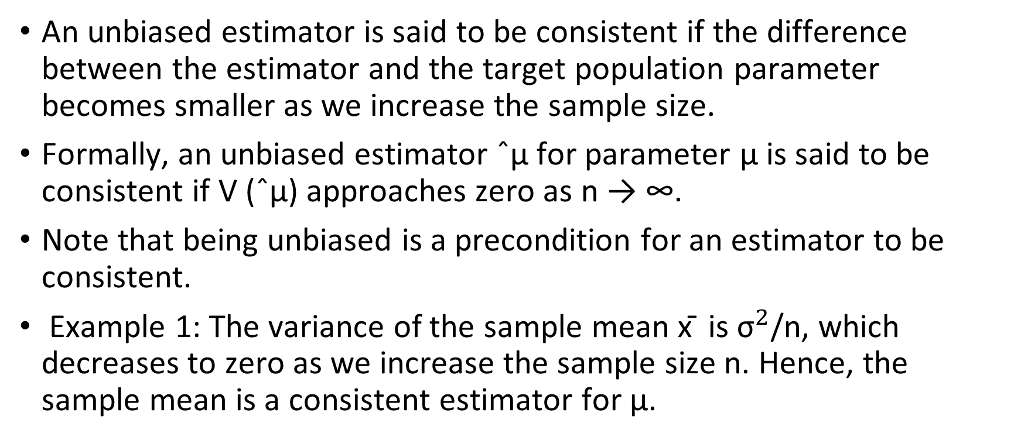
Consistency . . .
An unbiased estimator is said to be consistent if the difference between the estimator and the target population parameter becomes smaller as we increase the sample size.
Formally, an unbiased estimator ˆµ for parameter µ is said to be consistent if V (ˆµ) approaches zero as n → ∞.
Note that being unbiased is a precondition for an estimator to be consistent.
Example 1: The variance of the sample mean x ̄ is ${\text{σ}}^{2}$/n, which decreases to zero as we increase the sample size n. Hence, the sample mean is a consistent estimator for µ.

Slide 12
Efficiency . .
Suppose we are given two unbiased estimators for a parameter. Then, we say that the estimator with a smaller variance is more efficient.
Example 1: For a normally distributed population, it can be shown that the sample median is an unbiased estimator for µ. It can also be shown, however, that the sample median has a greater variance than that of the sample mean, for the same sample size. Hence, X¯ is a more efficient estimator than sample median

Slide 13
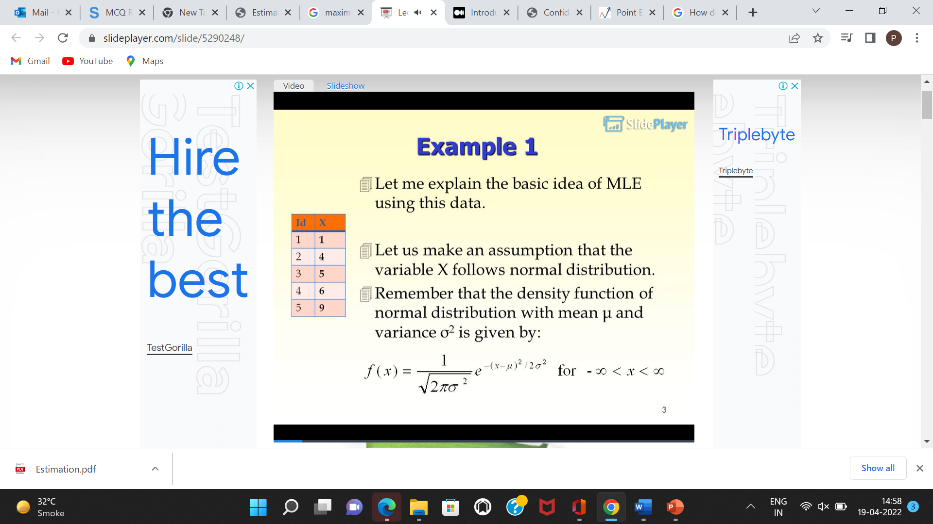
Maximum Likelihood
https://youtu.be/XepXtl9YKwc
Maximum likelihood estimation (MLE) is a method to find the most likely density function that would have generated the data.
MLE requires you to make a distributional assumption first.
Assume that the variable X follows normal distribution.
The density function of normal distribution with mean μ and variance σ2 is given by:

Slide 14
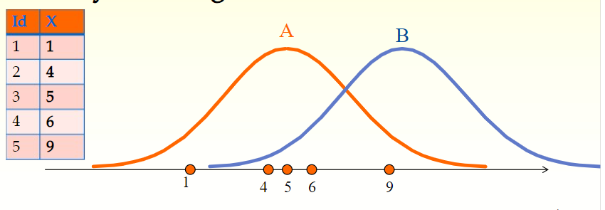
“Which distribution, A or B, is more likely to have generated the data?”
Answer to the question is A, because the data are clustered around the center of the distribution A, but not around the center of the distribution B.
This example illustrates that, by looking at the data, it is possible to find the distribution that is most likely to have generated the data.

Slide 15
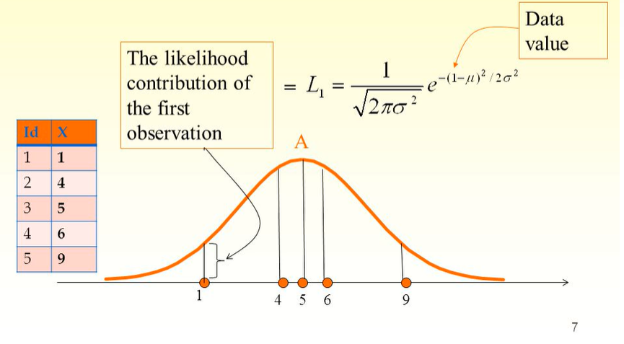
MLE starts with computing the likelihood contribution of each observation.
The likelihood contribution is the height of the density function.
We use Li to denote the likelihood contribution of ith observation.

Slide 16
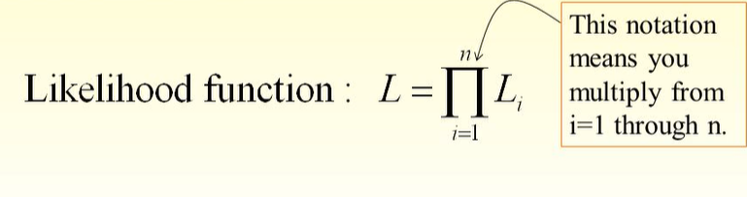
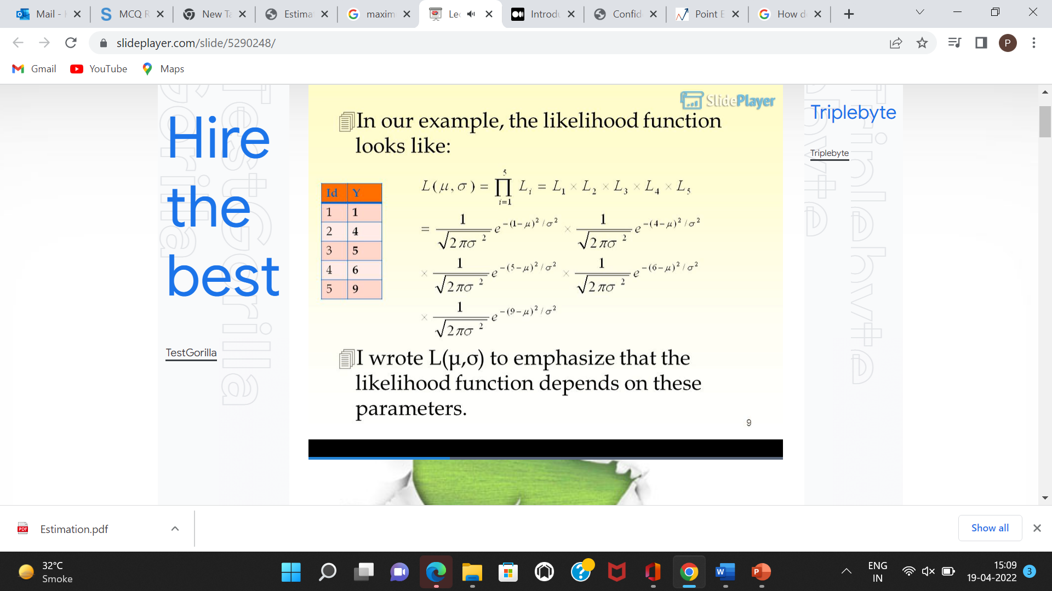
Then, you multiply the likelihood contributions of all the observations.
This is called the likelihood function. We use the notation L.
In our example, n=5.This notation means you multiply from i=1 through n.
L(μ,σ) to emphasize that the likelihood function depends on these parameters.

